Slide 1
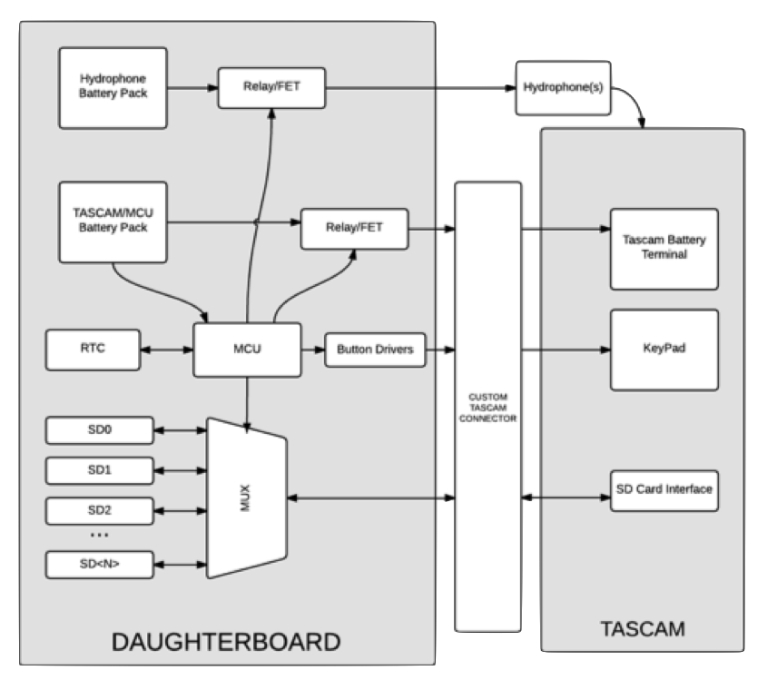
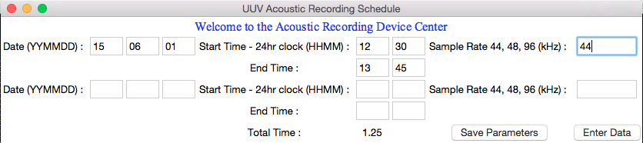
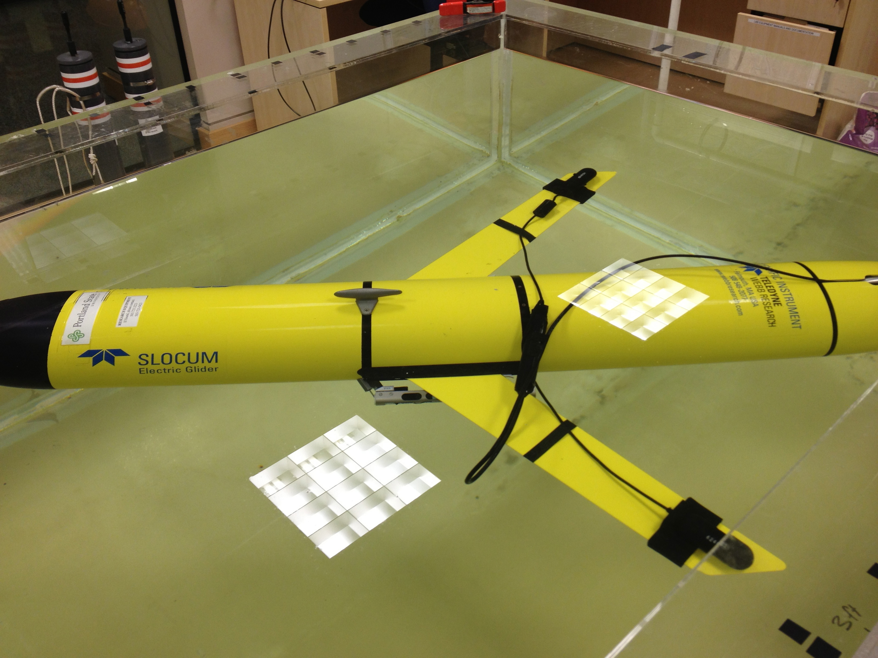
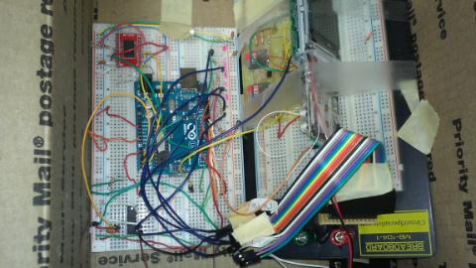
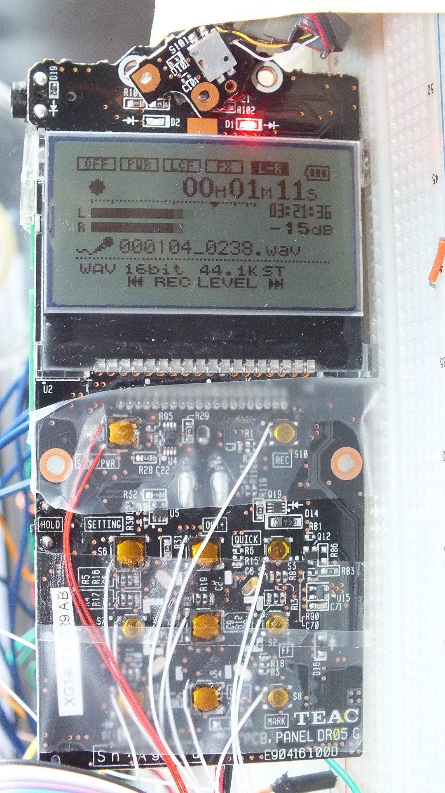
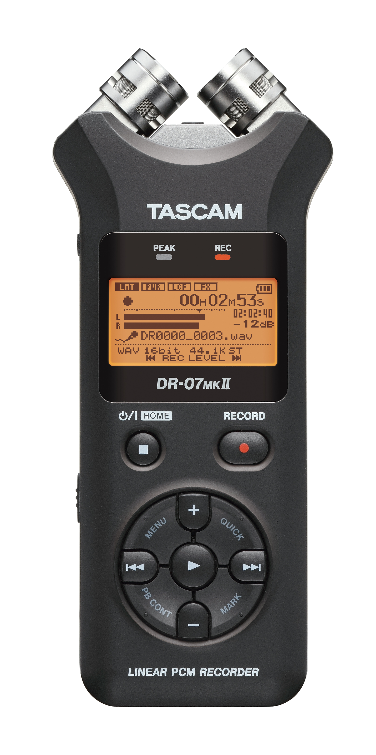

Underwater Glider Audio Recorder
Hardware
Three major updates to hardware:
Addition of a multiplexor to interchange up to 4, 32 GB microSD cards
Separate microcontroller unit and Real Time Clock chip to implement complex recording schedule
Button interface for hands-free
schedule programming
Data Storage
TASCAM supports microSD cards up to 32 GB
4 micro SD cards total, 128GB combined total storage to hold 4 days continuous recording
Button Interface
Must be able to turn on and off,
change sample rate, and record
without manually pressing buttons
Requires connection to
electrically end signal as if button
sequence is being pressed
Real Time Clock and MCU
PCF2127 was determined best choice for RTC chip with power consumption, temperature compensation, operating range, and I2C bus interface, communication capabilities with MCU
ATmega328p was determined best choice for MCU with on board EEPROM, I2C, low power, small sleep current, and ease of programming
Concept
There is an increasing interest in using underwater gliders for marine mammal research and monitoring. Portland State University’s Northwest Electromagnetics and Acoustics Research Laboratory (NEAR Lab) was previously implementing an off the self recording device with two hydrophones. The goal of this Capstone is to improve the usability of this device by designing additional software and hardware.
Software
Three components of software:
Pre-Mission user interface
In-Mission recording schedule control
Post–Mission data analysis
Pre-Mission
Allows user to program schedule record start and stop date and time and sample rate
In-Mission
RTC will awake MCU at determined schedule time. The MCU will run through the button sequence to set sample rate and begin recording
When finished recording, the Tascam will be turned off and the MCU put to sleep until next record time
Post-Mission
Removing SD card and place in laptop, list of data files are available for playback
Webb Slocum Glider
Integrated Prototype
Project Goals
To improve the usability and functionality of the
commercial recording device (TASCAM) these three
goals were developed:
To maintain an inexpensive device that includes a user interface for record time scheduling
Must be able to record broadband signals over 30 days,
with up to 4 days of continuous acoustic data
Must include both software and hardware update
Our Team
Electrical Engineering Students
Chelsea Throop
Phu Nguyen
Trevor Conant
Computer Engineering Students
Saida Akhter
Department of Electrical and Computer Engineering

